Slide 1
Bedside Shift Report
CGH Medical Center

Slide 2
What is patient and family engagement?
Patient and family engagement:
Creates an environment where patients, families, clinicians, and hospital staff all work together as partners to improve the quality and safety of hospital care.
Involves patients and family members as:
  Members of the health care team.
  Advisors working with clinicians and leaders to improve policies and procedures.

Slide 3
Patient and family-centered care
Patient and family engagement is an important part of providing patient- and family-centered care.
Core concepts of patient- and family-centered care:
  Dignity and respect
  Information sharing
  Involvement
  Collaboration
Research shows patient-centered approaches can improve:
  Patient safety
  Patient outcomes, including emotional health, functioning, and pain control
  Patient experience

Slide 4
Why focus on bedside shift report?
Transitions in care have potential for medical errors.
Research shows bedside shift report can improve:
  Patient safety and quality
    Improved communication
    Decrease in hospital-acquired complications
    Performing the focused assessment together decreases the likelihood of errors.
  Patient experiences of care
    Patients are an informed participant and part of the team.
    This communication instills trust and builds relationships.
  Time management and accountability between nurses
    Decrease in time needed for shift report
    Decrease in over shift time

Slide 5
What is bedside shift report?
Nursing staff conducts shift change reports
at the patient’s bedside and includes the patient in the conversation.
Patient can identify a family member or close friend to participate.
Report should take about 5 minutes per patient.
Purpose:
  To engage the patient and family in hospital care.
  To share accurate and useful information between nurses, patients, and families.

Slide 6
Critical elements of bedside shift report
Introduce the nursing staff, patient, and family.
Invite the patient and family to participate.
Open medical record or electronic workstation in the patient’s room.
Conduct a verbal SBAR report with the patient and family, using words they can understand.
Conduct a focused assessment of the patient and a safety assessment of the room.
Review tasks that need to be done. (labs or tests, medication administration, forms that need to be completed).
Identify needs and concerns of the patient and family.
  “What could have gone better in the last 12 hours?”
  “Tell us how much you walked today?”
  “Do you have any worries you would like to share?”
Ask the patient and family what the goal is for the next shift.
  “What do you want to happen during the next 12 hours?”

Slide 7
Benefits of bedside shift report for patients
Acknowledges patients as partners.
Builds trust in the care process.
  Shows the patient how much nurses know and do for them.
  Shows teamwork among the nursing staff, reassuring the patient that everyone knows what is going on with them.
Encourages patient and family engagement.
  Gives the patient and family an opportunity to ask questions and correct any inaccuracies in handoff.
  Informs the patient and family members about the patient’s care throughout the stay and helps with the transition to home.

Slide 8
Benefits of bedside shift report for nurses
Better information about the patient’s condition
Accountability
Time management
Patient safety

Slide 9
Tips for bedside shift report
Invite patients and family on admission to participate using a bedside shift report brochure. Tell patients and family what time report typically occurs.
You can use a checklist to help facilitate bedside shift report.
You can share sensitive information with the oncoming nurse before entering the room.
Make sure you are not just conducting report in front of the patient, but instead, including the patient and family in the conversation.
Thank the patient for allowing you to care for them and thank the nurse going off duty for a great report.

Slide 10
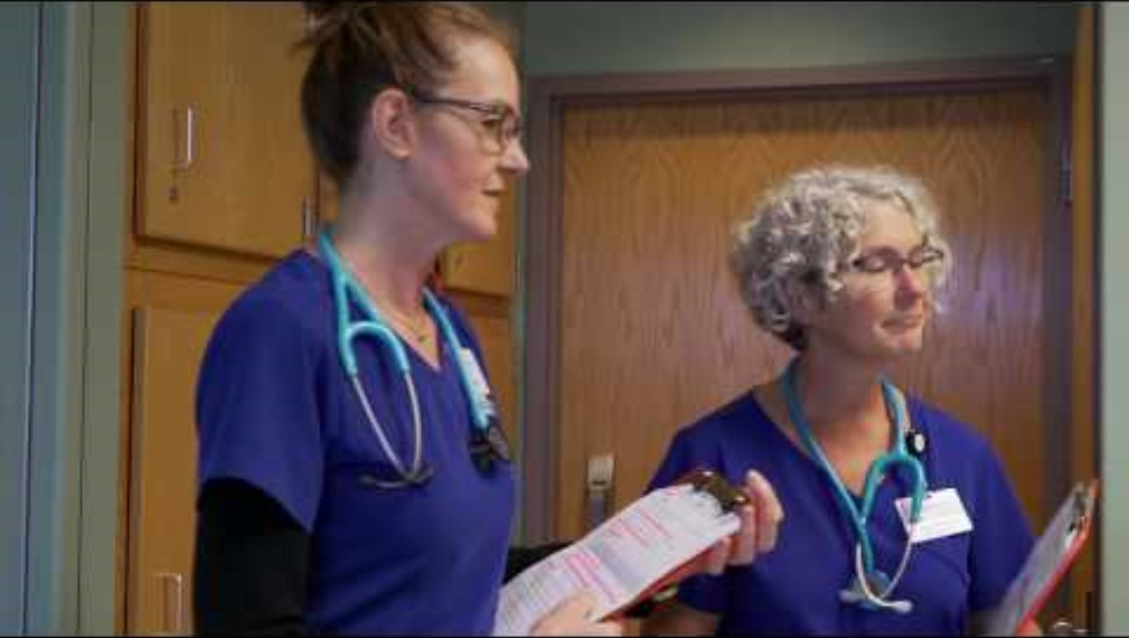
Video of bedside shift report
https://www.youtube.com/watch?v=RHpbuljThoc
Watch this video and complete the discussion questions found on the cgh heartbeat!
Send your responses to Kaitlin.Vandermyde@cghmc.com to be entered in a drawing.

